Slide 1

NEW JERSEY
PAID FAMILY & MEDICAL LEAVE

Slide 2


LEGAL DISCLAIMER
This presentation is intended as general information and not legal advice.
The NJ Register and the NJ Administrative Code remain the official sources for regulatory information published by the NJDOL.

Slide 3

WORKERS NEED TIME TO
GIVE AND RECEIVE CARE
The U.S. is the only advanced economy without a national paid family and medical leave policy – NJ is one of few states that has one!
NJ Paid Family and Medical Leave supports our health and the health of our families while advancing economic security, productivity at work, and gender equality.

Slide 4
THESE PROGRAMS HELP
BUSINESSES
Supports employee health
Boosts employee morale and job satisfaction
Improves employee retention which reduces turnover costs
Increases labor force participation, especially for women
Allows small businesses that cannot afford private plans to compete with larger organizations

Slide 5

NJ PAID FAMILY & MEDICAL LEAVE
NJ Temporary Disability Insurance (TDI)
NJ Family Leave Insurance (FLI)
State and Federal Job Protection Laws

Slide 6
BENEFITS CAN COVER
Illness (physical or mental) or injury
Pregnancy and childbirth recovery
Bonding with a new child
Caring for a loved one
Coping with domestic or sexual violence

Slide 7

EMPLOYER MUST BE COVERED
Most New Jersey employers are covered​.
NJ employers are required to participate in these programs or provide employees coverage through a private insurance plan.
• The federal government is exempt​
• Temporary Disability is optional for local governments, for example, counties, municipalities, and school districts​
Covered employers are required to set up payroll contributions for their employees. If they don’t set up contributions, an employee can still apply.
​
​
​
​
​
​
​
​
​
​

Slide 8
MUST MEET ELIGIBILITY REQUIREMENTS
Earnings must be with covered employer(s)​
Must meet earnings requirements; see myleavebenefits.nj.gov for the current year’s requirements​
Generally, employees working substantially outside of NJ are not covered; still encouraged to apply ​
Valid Social Security Number required in application​
Meet definition of an employee; properly classified independent contractors are not eligible. Learn more about misclassification at myworkrights.nj.gov ​
​
​
​

Slide 9
BENEFITS EMPLOYEES CAN RECEIVE
85% of average weekly wage up to a maximum
  See myleavebenefits.nj.gov for the current year’s max benefit level
For Temporary Disability Insurance: up to 26 weeks of benefits, as certified by a medical professional​
For Family Leave Insurance: up to 12 weeks of benefits if taken consecutively, 56 days of benefits if taken intermittently​

Slide 10
HOW ARE THE PROGRAMS FUNDED?
Temporary Disability Insurance: both employers and employees contribute to the cost of the program. Workers contribute through deductions taken out of their paychecks.
Family Leave Insurance: program is financed 100% by worker payroll deductions. Employers do not contribute to the program.

Slide 11
EMPLOYER REQUIREMENTS
Display TDI and FLI posters in a workplace location clearly visible to employees.
Provide written notice of TDI and FLI when an employee is hired, requests information, or notifies an employer of their need for leave.
Report employee’s quarterly earnings to the State.
We advise that employers keep track of notifications that an employee is receiving benefits, check for accuracy, and report discrepancies or incorrect payments.
The employer doesn’t play a role in the employee’s application.

Slide 12
HOW EMPLOYERS CAN HELP
Keep employees informed – use our toolkit and share resources: myleavebenefits.nj.gov/employerkit
Assist employees with their application - but it is employee's responsibility to submit a complete application
Direct employees to myleavebenefits.nj.gov to file a claim
Pay employees the difference between benefit rate and regular wages (employee would indicate this on their application)
Become familiar with and follow state and federal job protection laws

Slide 13
QUALIFYING REASONS FOR NJ PAID FAMILY & MEDICAL LEAVE
Let’s review the scenarios for which employee may receive Temporary Disability or Family Leave benefits.

Slide 14

CARING FOR THEMSELF: TEMPORARY DISABILITY INSURANCE
If an employee cannot work due to a physical or mental health condition, including pregnancy and child birth recovery
May receive up to 26 weeks of benefits, as certified by a medical professional

Slide 15
CARING FOR A LOVED ONE:
FAMILY LEAVE INSURANCE​
If an employee cannot work because they are:
Caring for a loved one with a physical or mental health condition
Caring for a loved one who is coping with domestic or sexual violence
You can care for a loved one regardless off their immigration status.
Duration:
Up to 12 weeks of benefits if taken consecutively
56 days (8 weeks) of benefits if taken intermittently

Slide 16
CARING FOR A LOVED ONE:
FAMILY LEAVE INSURANCE (CONTINUED)
Who is a considered a “Family Member” in the law?
Child (biological, adopted, foster, stepchild)
Spouse (includes domestic partner and civil union partner)
Parents
Siblings
Grandparents
Grandchildren​
In-laws
Any blood-relation to the claimant
Chosen family
Any other individual with a close association equivalent of a family relationship

Slide 17
BENEFITS FOR NEW PARENTS:
TEMPORARY DISABILITY & FAMILY LEAVE INSURANCE
Typical benefits for a birthing parent without complications:
  4 weeks for pregnancy, leading up to the due date
  + 6/8 weeks for recovery
  + 12 weeks for bonding (56 intermittent days)
  = up to 24 weeks total

Slide 18
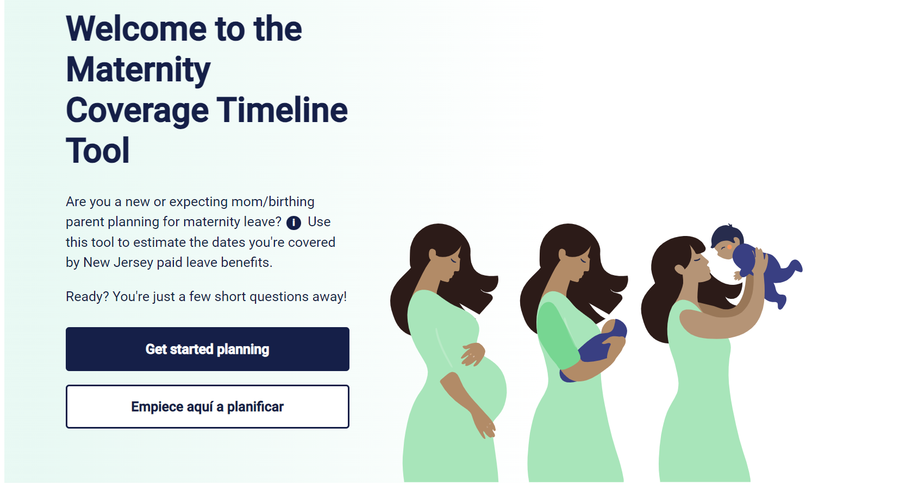
MATERNITY TIMELINE TOOL
myleavebenefits.nj.gov/timeline

Slide 19
BONDING WITH A NEW CHILD:
FAMILY LEAVE INSURANCE
Both parents can receive Family Leave benefits to bond with a child within a year of the child’s birth, adoption, or foster placement​.
Up to 12 weeks of benefits if taken consecutively, 56 days of benefits if taken intermittently.

Slide 20
COPING WITH DOMESTIC OR
SEXUAL VIOLENCE: FAMILY LEAVE OR TEMPORARY DISABILITY INSURANCE
The employee can apply for Family Leave benefits to cope with domestic or sexual violence such as:
  Seeking medical attention, therapy, victim advocacy, or legal services​
  Safety planning or escaping abuse, such as staying in a domestic violence shelter​
  Attending or preparing for court​
Must apply by paper for FLI to cope with DV/SV.
Employee can also receive Temporary Disability benefits as certified by a medical provider.
myleavebenefits.nj.gov/survivors

Slide 21
UNEMPLOYMENT, TEMPORARY DISABILITY & FAMILY LEAVE
Unemployed workers may be eligible for Family Leave During Unemployment or Disability During Unemployment. See myleavebenefits.nj.gov/unemployed.
Workers can apply for unemployment benefits if they are laid off when receiving paid leave benefits. See myunemployment.nj.gov.

Slide 22
FAMILY LEAVE FOR PART-TIME EMPLOYEES
Employees with multiple jobs may receive Family Leave benefits if they only take leave from one employer. They cannot exceed their usual work schedule in their other job.
Employees with multiple jobs may receive Family Leave benefits if they take leave from more than one employer.
Benefit rate will be based on the wages from the employment from which they are taking leave.

Slide 23
INJURED AT WORK?
TEMPORARY DISABILITY VS. WORKERS’ COMPENSATION
Temporary Disability benefits cover non-work-related illness or injury.
Workers’ Compensation benefits cover work-related illness or injury. The worker should notify the employer immediately if they are injured on the job.
The employer’s insurance carrier determines if the worker is eligible to receive Workers’ Compensation benefits. If a worker is determined to not be eligible, they can file a claim to contest the decision with NJ Division on Workers’ Compensation. Learn more at nj.gov/labor/wc.
While their appeal is pending, they may qualify for Temporary Disability Insurance benefits. If they’re awarded workers compensation benefits, any Temporary Disability benefits they received must be returned to the State of NJ. The funds are typically returned by the Workers’ Compensation insurance carrier on the worker’s behalf.

Slide 24
TIPS ON APPLYING
It can take a number of weeks to get approved or denied – so plan ahead to the best of your ability. To speed up processing, make sure you don’t miss any requirements when you apply.
View the application video guides: myleavebenefits.nj.gov/appvideos.
We recommend applying online—but you can also apply by mail or fax.
A trusted person can help you fill out the application.
For TDI, you can list a representative on your application.
Follow up with your medical provider to ensure they submitted their portion of the application (when required).

Slide 25
AFTER YOU APPLY
Read the “What Happens After I Apply” webpage: myleavebenefits.nj.gov/status
Check your claim status online
Division of Temporary Disability and Family Leave Insurance
  Phone: 609-292-7060
  8:00am - 4:30pm, Monday – Friday (except holidays)
  Wait time: Monday, Tuesday, Wednesday, Thursday, Friday
Call center menu is in English/Spanish and we have Spanish-speaking agents. For other languages, agents conference in Language Line and an interpreter is provided.

Slide 26
AFTER YOU APPLY
Fax: 609-984-4138
“Contact Us” form at myleavebenefits.nj.gov/email
Hearing Impaired Customers
Telecommunication Device for the Deaf (TDD): 609-292-8319
New Jersey Relay Service - TT User: 800-852-7899
New Jersey Relay Service - Voice User: 800-852-7897
Debit Card Help: myleavebenefits.nj.gov/payment or call 888-292-0059

Slide 27
HOW YOU’LL GET PAID
We pay benefits using a debit card
  Step 1: Check your mail. Once your application is approved, you'll be mailed a Money Network/My Banking Direct Visa debit card in a plain envelope with an Omaha, NE return address.
  Step 2: Activate your card
  Step 3: Use your card wherever VISAs are accepted
  Debit Card Help: myleavebenefits.nj.gov/payment or call 888-292-0059

Slide 28
PRIVATE PLANS
Employers can choose to provide benefits through private plans instead of the State plan. These private plans must be approved by the Division and offer the same or better benefits.
Private plans are more common for Disability benefits. About 1/3 of NJ workers are covered under private plans.
Contact your employer’s HR Department to learn how to apply directly with the insurer to avoid delays. If you apply through NJDOL’s application by mistake, it will take 4-5 weeks to be redirected.

Slide 29
PRIVATE PLANS
Sometimes private plan insurers deny claims that should be eligible. If they wrongfully deny your claim or don’t give the full benefits you’re owed, we can work with the insurer to correct this. You have one year to appeal the insurer’s decision with us. You can send your appeal by mail or online.
Contact us via this online form.

Slide 30
JOB PROTECTION
Temporary Disability and Family Leave Insurance do not provide job protection.
However, an employee’s job may be protected under state or federal law.

Slide 31

JOB PROTECTION​
Federal Family & Medical Leave Act (FMLA, 50+ employees)
  Enforced by US Department of Labor
New Jersey Family Leave Act (NJFLA, 30+ employees)
  Enforced by the NJ Division on Civil Rights
New Jersey SAFE Act (25+ employees)
Additional requirements apply.
Learn more: myleavebenefits.nj.gov/jobprotection

Slide 32
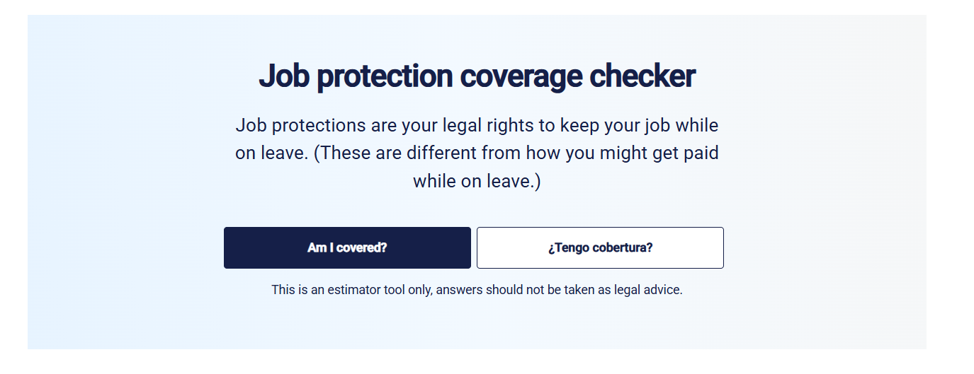
JOB PROTECTION COVERAGE TOOL
myleavebenefits.nj.gov/jobprotection

Slide 33
FEDERAL FAMILY & MEDICAL LEAVE ACT (FMLA)
Enforced by US Department of Labor: dol.gov/agencies/whd/fmla
Up to 12 weeks of unpaid, job-protected leave in a 12-month period to:
  Care for their own illness or injury
  Care for a spouse, child, or parent with a serious health condition
  Bond with a newborn, newly adopted, or foster child

Slide 34
FEDERAL FAMILY & MEDICAL LEAVE ACT (FMLA)
Generally all requirements must be met or an employer is not required to hold an employee’s job:
Employer has 50 or more employees within 75 miles of the worksite, or is a government entity of any size
Employee worked there for at least 12 months
Employee worked at least 1,250 hours in the past 12 months
Employee gave employer 30 days’ notice if need for leave is foreseeable

Slide 35
NEW JERSEY FAMILY LEAVE ACT (NJFLA)
Enforced by the NJ Division on Civil Rights: njcivilrights.gov
Employees can receive up to 12 weeks of unpaid, job-protected leave every 24 months to:
Care for or bond with a newborn, newly-adopted, or foster child
Care for a family member, or someone who is the equivalent of family, with a serious health condition
Provide required care or treatment for a child if their school or place of care is closed due to a public health emergency (like COVID-19)

Slide 36
NEW JERSEY FAMILY LEAVE ACT (NJFLA)
Generally all requirements must be met or an employer is not required to hold the employee’s job:
Employer has 30 or more employees worldwide, or is a government entity of any size
Employee worked there for at least 12 months
Employee worked at least 1,000 hours in the past 12 months (furlough/layoff exceptions)
Employee gave employer notice if the leave is foreseeable (some exceptions)

Slide 37

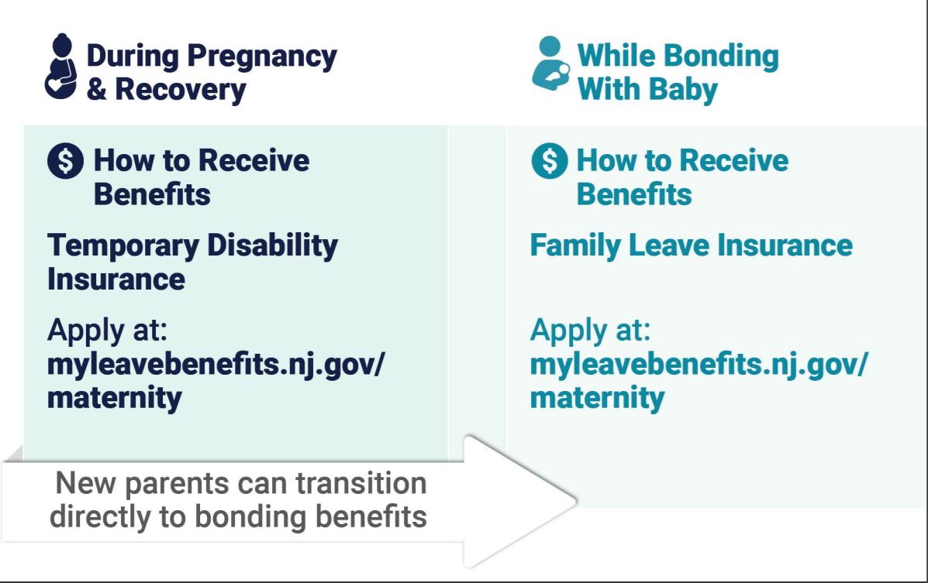
PAID AND JOB-PROTECTED LEAVE FOR MATERNITY

Slide 38
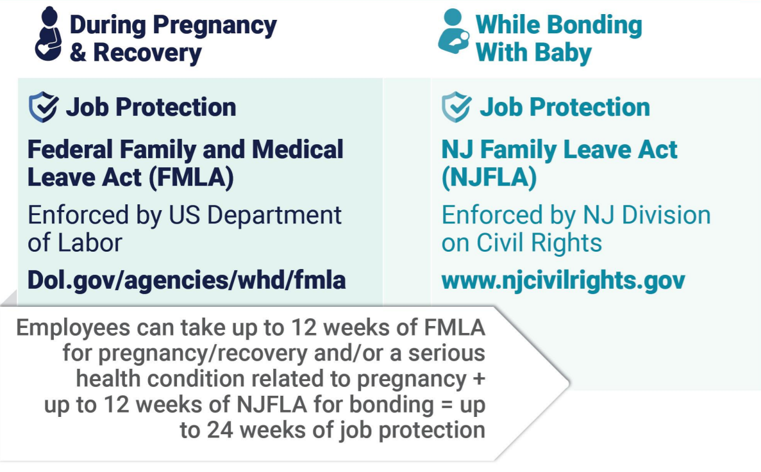
PAID AND JOB-PROTECTED LEAVE FOR MATERNITY

Slide 39
NJ SAFE ACT
Employees can receive up to 20 days of unpaid, job protected leave to cope with domestic or sexual violence
Generally applies to employers with 25 or more employees and government agencies
Learn more at myleavebenefits.nj.gov/jobprotection

Slide 40
RETALIATION
It is unlawful for an employer to retaliate against an employee for taking or seeking to take TDI/FLI benefits. Retaliation includes, but is not limited to:
    Firing them
    Reducing their salary
    Increasing oversight on their job duties
    Changing their workplace responsibilities
    Excluding them from meetings
If retaliation occurs, the employee has the right to take private legal action.

Slide 41
NJ LAW AGAINST DISCRIMINATION
The NJ Law Against Discrimination prohibits discrimination and harassment and requires employers to provide reasonable accommodations, including for disability, pregnancy and breastfeeding.
Learn more: njcivilrights.gov/

